Slide 1
Trajectory

Slide 2
Path Planning in Robotics
Path planning is the process of determining a collision-free route from a start position to a goal position.
Key Idea
Find where to move (geometry)
Not necessarily how fast (that’s trajectory planning)
Path - geometric route (no time)
Trajectory - path + timing
Important - planning vs execution

Slide 3

Path vs Trajectory
Path - geometric route (no time)
Trajectory - path + timing. The position of the robot as a function of time q(t) where q is robot position and t is time
The robot’s position is defined for every moment in time from $t_{0}$to $t_{f}$(time zero to time final)
Term | Definition | Parameters
Path | Geometric locus of points (no time) | q(s), s∈[0,1]
Trajectory | Path + time + velocity + acceleration | q(t), velocity, acceleration

Slide 4
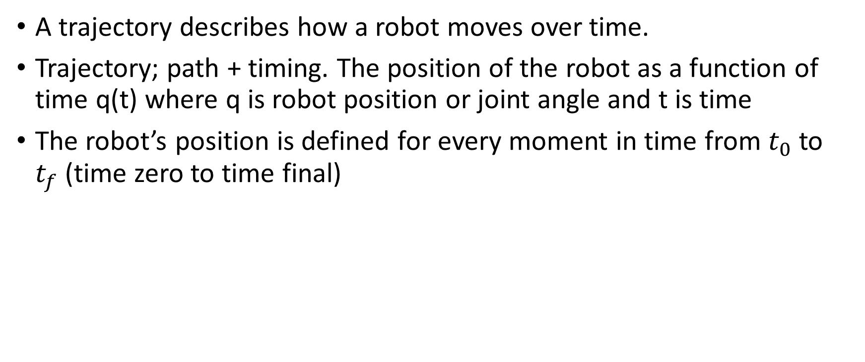
Trajectory
A trajectory describes how a robot moves over time.
Trajectory; path + timing. The position of the robot as a function of time q(t) where q is robot position or joint angle and t is time
The robot’s position is defined for every moment in time from $t_{0}$to $t_{f}$(time zero to time final)

Slide 5
Joint vs Cartesian Space
Joint space
Path in 𝒞‑space: q(t)
No Inverse Kinematics needed, smooth joint motion
End‑effector motion unpredictable
Cartesian Space
intuitive motion
Path in workspace x(t), orientation
Intuitive for tasks requiring specific tool paths
Inverse Kinematics at each step, singularities

Slide 6
Types of trajectory
Joint Space Trajectory
Plan motion in joint angles
q(t) = [θ1 (t), θ2(t), … ]
Used in robot arms
Cartesian Space Trajectory
Plan motion in task space
x(t), y(t), z(t)
Requires inverse kinematics

Slide 7
Trajectory Requirements
A good trajectory must
Start and end at correct positions
Be smooth
Respect velocity & acceleration limits
Avoid sudden jerks

Slide 8

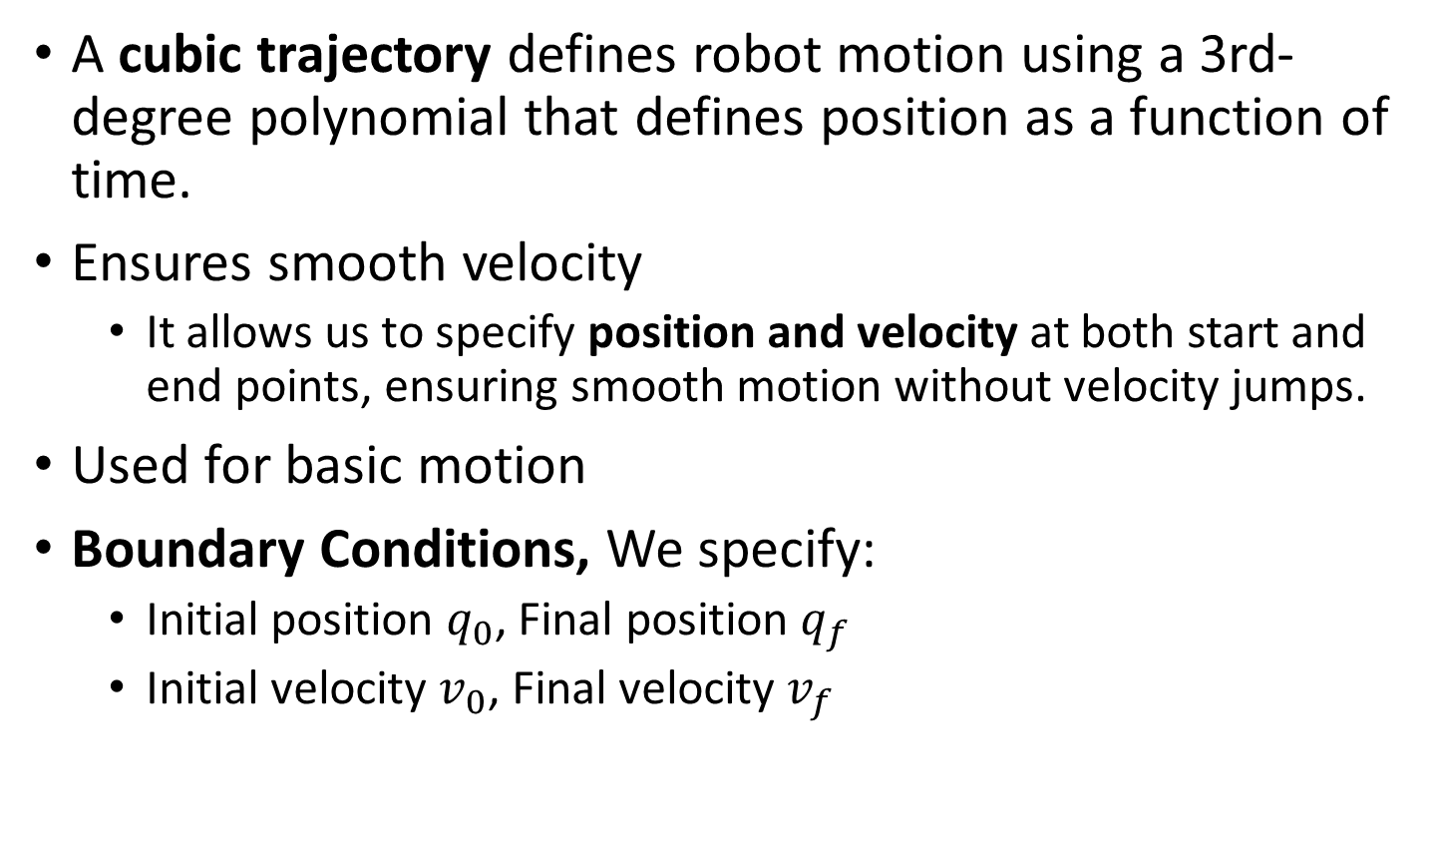
Polynomial Trajectories - Cubic Trajectory
A cubic trajectory defines robot motion using a 3rd-degree polynomial that defines position as a function of time.
Ensures smooth velocity
It allows us to specify position and velocity at both start and end points, ensuring smooth motion without velocity jumps.
Used for basic motion
Boundary Conditions, We specify:
Initial position $q_{0}$, Final position $q_{f}$
Initial velocity $v_{0}$, Final velocity $v_{f}$

Slide 9


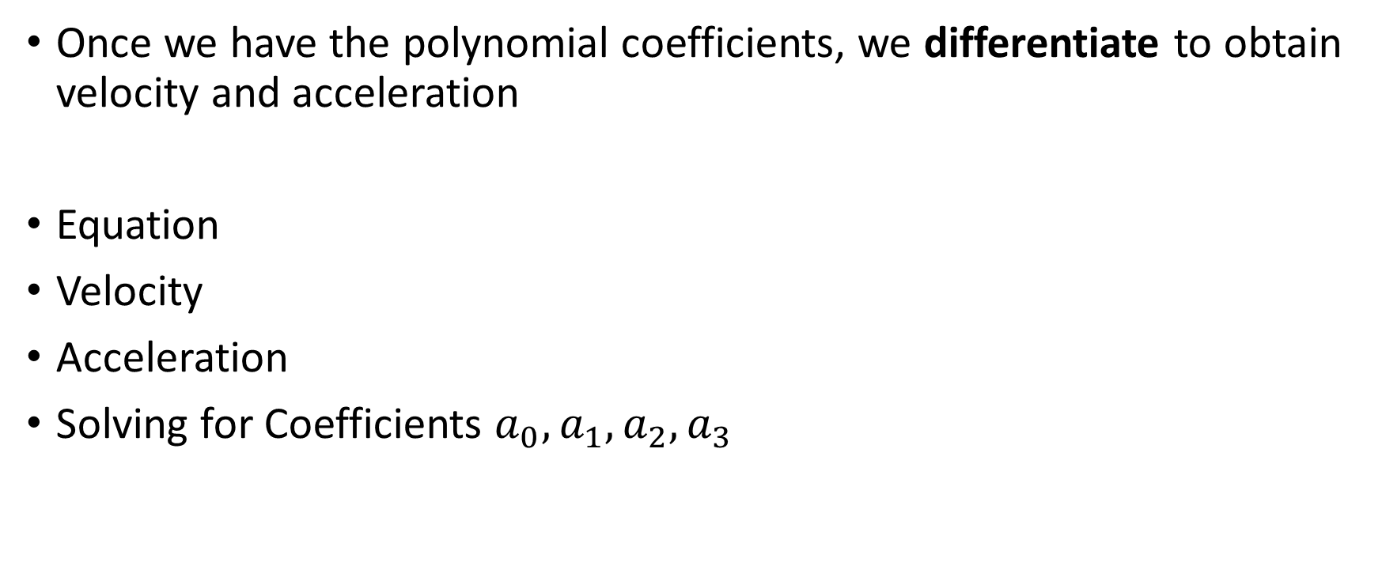
Cubic Trajectory
Once we have the polynomial coefficients, we differentiate to obtain velocity and acceleration
Equation
Velocity
Acceleration
Solving for Coefficients $a_{0}, a_{1}, a_{2}, a_{3}$

Slide 10
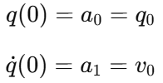
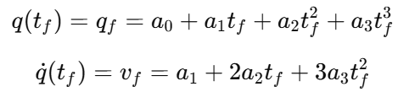

Cubic Trajectory - Solving for Coefficients
Coefficients $a_{0}, a_{1}, a_{2}, a_{3}$
Step 1: At t=0
Step 2: At t=$t_{f}$

Slide 11
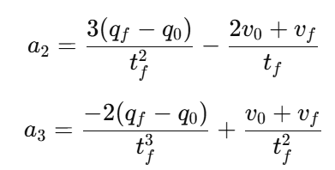

Cubic Trajectory - Solving for Coefficients
Coefficients $a_{0}, a_{1}, a_{2}, a_{3}$
Step 3: Solve for $a_{2}, a_{3}$

Slide 12



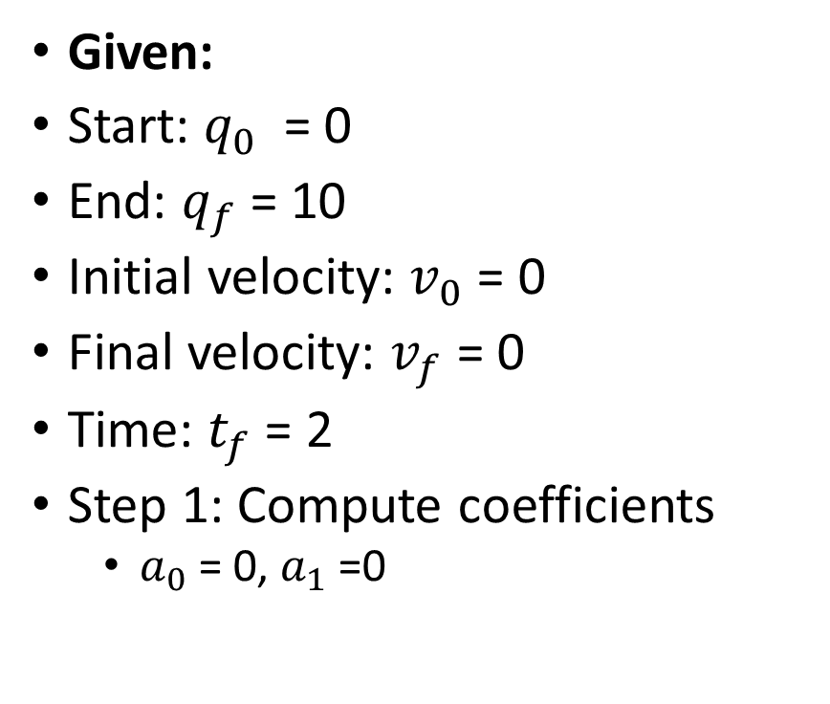
Worked example
Given:
Start: $q_{0}$ = 0
End: $q_{f}$= 10
Initial velocity: $v_{0}$= 0
Final velocity: $v_{f}$= 0
Time: $t_{f}$= 2
Step 1: Compute coefficients
$a_{0}$= 0, $a_{1}$=0
Compute a₂
Compute a₃
Step 2: Final Equation (degrees)
Check q(t) when t = 0, 2

Slide 13
Quintic Trajectories in Robotics
A quintic trajectory is a 5th-degree polynomial used in motion planning to generate smooth paths for robotic systems.
It has the general form: q(t) = a₀ + a₁t + a₂t² + a₃t³ + a₄t⁴ + a₅ t⁵ Where:
q(t): position
q˙(t) : velocity
q¨(t): acceleration
a₀ … a₅ ​: coefficients determined by boundary conditions

Slide 14
Why Quintic Trajectories?
Quintic polynomials are preferred because they allow control over:
Position
Velocity
Acceleration
at both the start and end points of motion.
This gives 6 boundary conditions, matching the 6 coefficients.
Ensures smooth motion.

Slide 15
Boundary Conditions
For a motion from time t= 0 to t=T, we define:
At t = 0:
q(0) = q₀ position
q˙(0) =v₀ velocity - change in position over time
q¨(0) =a₀ Acceleration - change in velocity over time
At t=T:
q(T)=q_{f} ​
q˙(T)=v_{f}
q¨(T)=a_{f}
These constraints ensure smooth start and stop.

Slide 16
Acceleration constraints
Acceleration constraints are critical because
High acceleration can damage actuators
Causes mechanical stress
Reduces system lifespan
Acceleration is the second derivative
q¨​(t )= 2a₂​ + 6a₃​t + 12a₄​t² + 20a₅​t³
Key properties
Acceleration is continuous
Can be constrained at endpoints
Avoids sudden jumps (unlike cubic trajectories)
Practical Constraint Handling
Set a₀​ = 0 and a_{f} =0 for smooth rest-to-rest motion
Limit peak acceleration using
Time scaling (increase T)
Optimization-based trajectory generation

Slide 17
Jerk Control
Jerk is the rate of change of acceleration, Jerk = d³q / dt³
For quintic trajectories, q′′′(t) = 6a₃​ + 24a₄​t + 60a₅​t²
Why Jerk Control Matters
Reduces vibration
Prevents oscillations
Improves tracking accuracy
Enhances user safety (especially in human-robot interaction)

Slide 18
Comparison
Advantages of Quintic Trajectories
Continuous jerk profile
No abrupt acceleration changes
Smooth transition between motion phases
Comparison
Cubic: Discontinuous acceleration
Quintic: Smooth acceleration and jerk
Trajectory Type | Position | Velocity | Acceleration | Jerk
Cubic | Smooth | Smooth | Discontinuous | Infinite spikes
Quintic | Smooth | Smooth | Smooth | Continuous

Slide 19
Applications
Industrial robots
Medical robots
Autonomous vehicles
Semiconductor systems
CNC machines - Computer Numerical Control machines in robotics are automated manufacturing systems that use programmed instructions to control tools and machinery with high precision.

Slide 20
Applications
Quintic trajectories are widely used in high-precision systems
a) Industrial Robotics - Robotic arms (e.g., assembly lines), Welding and painting robots
Ensures smooth tool motion and high accuracy
b) Medical Robotics - Surgical robots, Prosthetics and rehabilitation devices
Requires extremely smooth motion to avoid harm
c) CNC Machines - Tool path planning
Minimizes vibration and improves surface finish
d) Autonomous Systems Drones and self-driving vehicles
Smooth navigation and passenger comfort
e) Semiconductor Manufacturing Ultra-precise positioning systems
Nanometer-level accuracy requirements

Slide 21
Advantages and limitations
Key Advantages
Limitations
Smooth position, velocity, and acceleration profiles
Reduced mechanical wear and tear
Improved control stability
Better tracking performance
Ideal for high-speed, high-precision tasks
Computationally more complex than lower-order polynomials
May require optimization for strict constraints
Not always sufficient for highly dynamic environments (may need spline-based or jerk-limited profiles)

Slide 22
Quintic trajectories
Quintic trajectories are a powerful tool in robotic motion planning, especially where
Smoothness is critical
Acceleration and jerk must be controlled
Precision and safety are required
They strike a balance between mathematical simplicity and physical realism, making them a standard choice in modern robotics.
Quintic trajectories are ideal for precision robotics requiring smooth, safe, and accurate motion.

Slide 23
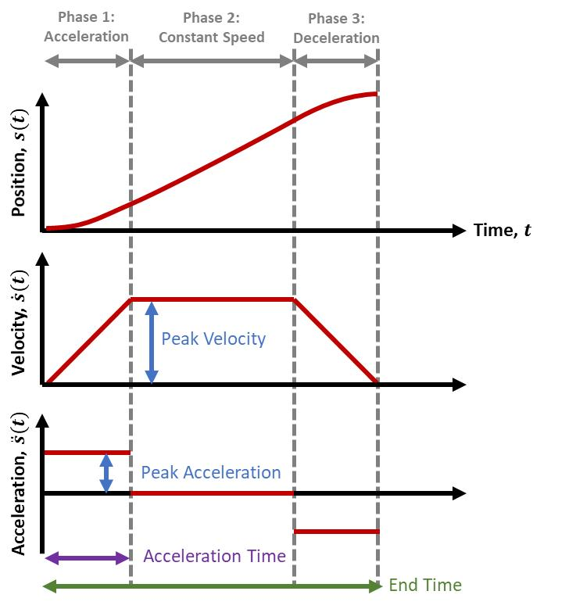
Linear Segment with Parabolic Blend (LSPB) Trajectory
Idea
Accelerate
Move at constant speed
Decelerate
Velocity Profile
Start → acceleration
Middle → constant velocity
End → deceleration
Trapezoidal velocity
Phases - accel, constant, decel
Efficient and simple

Slide 24
Example - LSPB Trajectory
Given:
Distance = 10 m
Max velocity = 4 m/s
Acceleration = 2 m/s²
Step 1: Time to accelerate t_{a}=v/a = 4/2 = 2 s
Step 2: Distance during acceleration d_{a}​=1/2(​at²) = 4
Step 3: Remaining distance 10−2(4) = 2
Step 4: Constant velocity time t_{c}​ = 2/4 ​=0.5 s
Total time T = 2 + 0.5 + 2 = 4.5 s
Total motion time = time to speed up + time at full speed + time to slow down
The Three Phases
1. Acceleration Phase
t₁ ​ = 2 s
Robot speeds up from 0 to max velocity
Motion is accelerating
2. Constant Velocity Phase
t₂ ​= 0.5 s
Robot moves at maximum speed
No acceleration
3. Deceleration Phase
t₃​ = 2 s
Robot slows down to stop
Motion is decelerating
https://www.mathworks.com/help/robotics/ug/design-a-trajectory-with-velocity-limits-using-a-trapezoidal-velocity-profile.html?utm_source=chatgpt.com

Slide 25
Multi-Point Trajectory (Spline)
Idea - Pass through multiple points smoothly q₀ ​→ q₁ ​→ q₂​ → q₃​
Use - Cubic splines, B-splines
Ensures smooth motion

Slide 26
S-Curve Profile
Limits jerk
Smooth transitions
Used in high precision systems

Slide 27
Cubic Spline Example
In robotics, we often want a robot to move through multiple points:
q₀ ​→ q₁ ​→ q₂​ → q₃​
A single polynomial is NOT enough because:
it becomes unstable
it cannot maintain smoothness across many points
Solution: Splines
Key Idea: “Break the motion into smaller smooth pieces and join them together.”

Slide 28
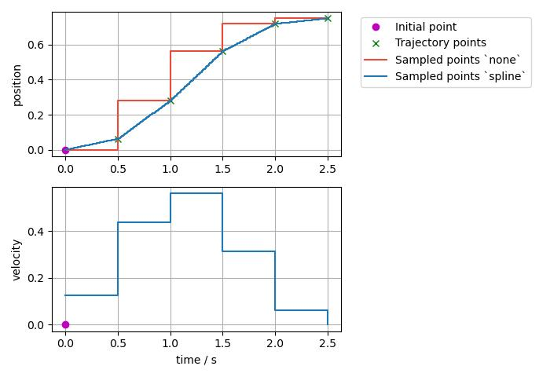
Cubic spline
A cubic spline is a set of piecewise cubic polynomials, one between each pair of points.
For points: q₀​, q₁​, q₂​, q₃​
We define:
Segment 1: between q₀→q₁
Segment 2: between q₁→q₂ ​
Segment 3: between q₂→q₃ ​
Each segment: q_{i}(t) = a_{i} + b_{i}t + c_{i}t2 + d_{i}t3

Slide 29
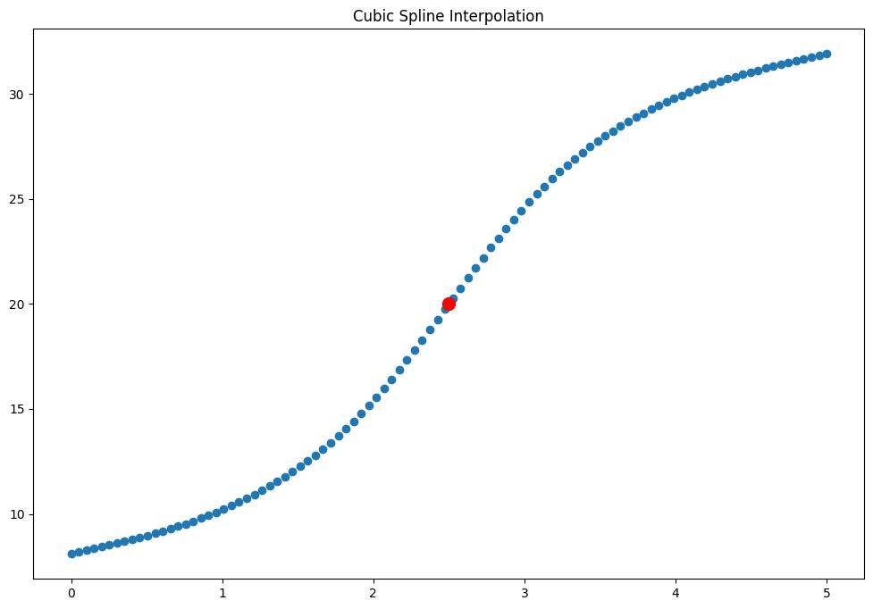
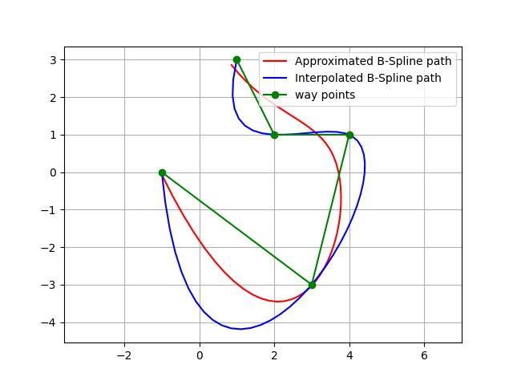
Conditions for cubic spline
At each connecting point:
Position must match
Velocity must match
Acceleration must match
This ensures
Smooth motion
No jerks
Continuous acceleration

Slide 30
Conditions for cubic spline
Given Points
q₀ ​= 0, q₁​ = 5, q₂ ​= 8, q₃​ = 10
What happens?
Robot moves from 0 → 5 smoothly
Then 5 → 8 smoothly
Then 8 → 10 smoothly
No sharp turns or stops
Why Cubic Splines Are Good
Smooth motion
Passes exactly through all points
Easy to compute
Limitation
Changing one point affects the whole curve

Slide 31
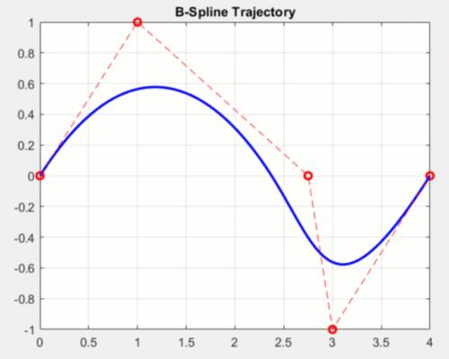
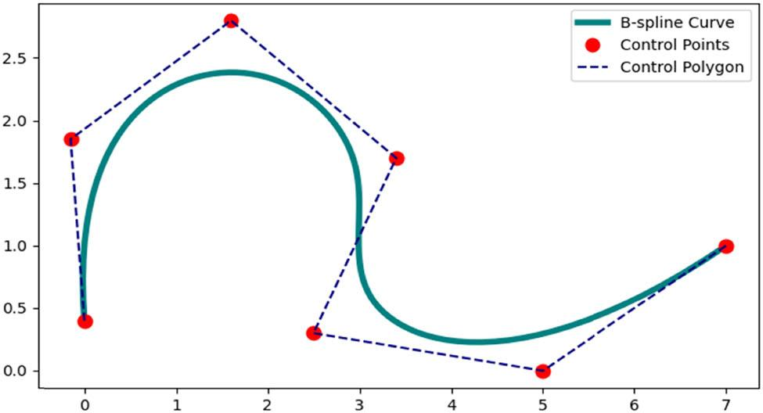
B-Splines (Basis Splines)
A B-spline is a smooth curve controlled by control points, but:
It does NOT necessarily pass through all points
Key Idea : “Control the shape of the curve using nearby points instead of forcing it through every point.”
Instead of interpolation:
q(t) = ∑ B_{i}​(t)P_{i}​
Where:
P_{i}​ = control points
B_{i}(t) = basis functions

Slide 32
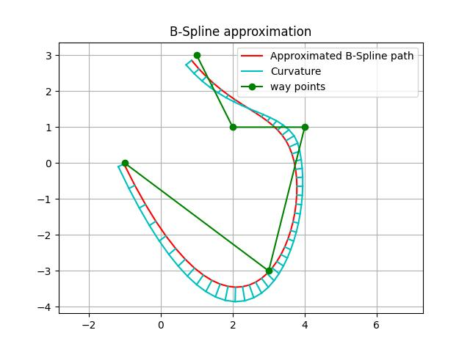
Example (B-Spline)
Control Points:
P₀ = (-1,0), P₁ = (-3,3), P₂ = (4,1), P₃ = (2,1) p4 = (1,3)
The curve:
does NOT pass through all points
stays close to them
forms a smooth path
Key Property - Local Control
If you move one control point
Only part of the curve changes
Not the entire curve

Slide 33
Cubic Spline vs B-Spline
Feature | Cubic Spline | B-Spline
Passes through points | Yes | No
Smoothness | High | Very high
Control | Global | Local
Stability | Moderate | Very stable
Use Cubic Splines when
Robot must pass through exact points
Waypoints are critical
Use B-Splines when
Smoothness is more important
You want flexible shape control
Avoid sharp changes

Slide 34
Robotics Application
Cubic Splines
Industrial robot arms
Pick-and-place tasks
“Go exactly through every point smoothly.”
Cubic spline → interpolates points
B-Splines
Autonomous vehicles
Drone flight paths
Animation and smooth navigation
Follow the general direction of points with maximum smoothness.”
B-spline → approximates points
Both ensure smooth trajectories

Slide 35
Trajectory Architecture (planning pipeline)
Planner → Generator → Controller
Ensures smooth execution
Path planning
Time assignment
Trajectory generation
Control execution

Slide 36
Applications of trajectory
Trajectory planning is used in:
robotic arms
mobile robots
drones
autonomous vehicles
Frameworks like: ROS MoveIt
Motion planning framework
Uses RRT/PRM
Handles Inverse Kinematics and trajectories
Trajectory planning tells the robot not just where to go, but how fast and how smoothly to get there.
Always remember
q(t) defines motion
Cubic → position + velocity
Quintic → position + velocity + acceleration
LSPB → practical velocity profile

Slide 37
Obstacle Avoidance
Obstacle avoidance
Ensures that a robot:
Moves from start → goal
Without colliding with obstacles
Key Idea - “Every motion must be checked for safety before execution.”
Configuration Space (C-Space)
Instead of thinking about the robot in physical space
Represent robot as a point in configuration space
Example
A 2D robot → position (x, y)
A robotic arm → joint angles (θ₁​, θ₂​, …)
Important
Obstacles become C-obstacles
Free space = valid region

Slide 38
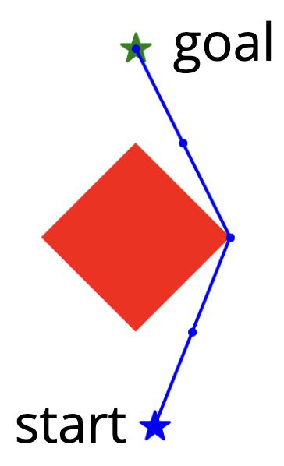
Collision Checking
Determines Whether a robot configuration or motion is collision-free
Types of Collision Checking
1. Point Collision Check
Check a single configuration: q = (x, y)
Is it inside obstacle? → ❌ collision
Outside? → ✅ safe
2. Path Collision Check
Check motion between two points: q₁ ​→ q₂
Method:
Divide path into small segments
Check each segment
Algorithms Used
Bounding boxes
Mesh intersection
Distance threshold methods

Slide 39
Distance Fields
A distance field assigns the distance from each point to the nearest obstacle
Mathematical Form d(x, y) = distance to nearest obstacle
Types
1. Unsigned Distance Field
Only gives distance
Always positive
2. Signed Distance Field (SDF) d(x) = {+outside obstacle−inside obstacle​}
Why Distance Fields Are Useful
They provide:
Clearance information
Smooth gradients
Safer paths
Example : Obstacle at center:
Point near obstacle → distance = small
Far point → distance = large
Use in Safety - Robot should maintain d(x) > dsafe

Slide 40
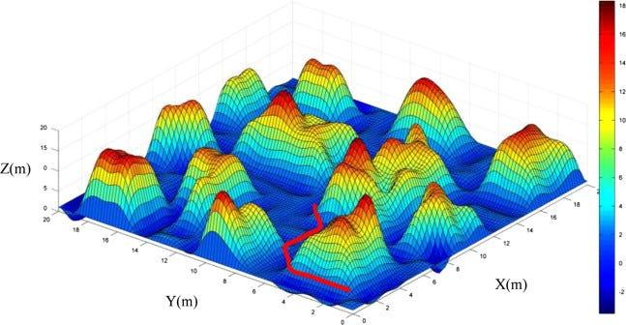
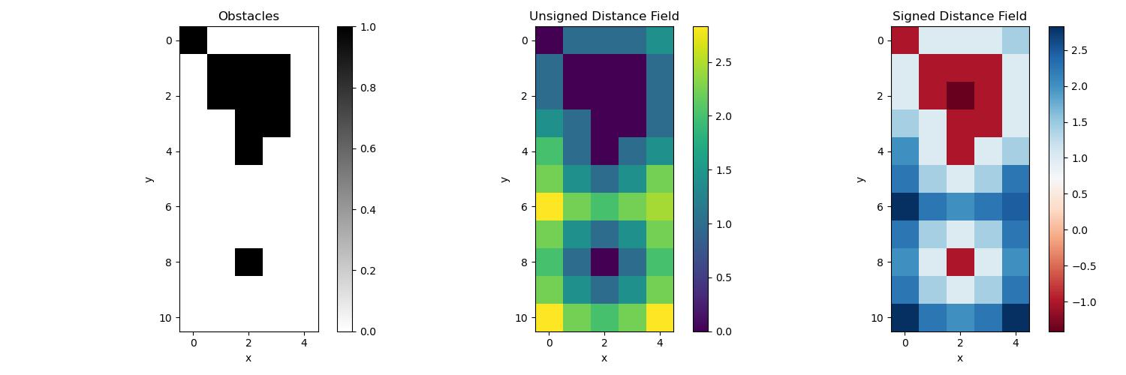
Distance Fields in Motion Planning
Use Cases
Collision checking
Path optimization
Gradient-based planning
Example - Robot prefers path:
Far from obstacles
Smooth

Slide 41
Use in PRM (Probabilistic Roadmap)
How PRM Uses Collision Checking
Sample random points
Keep only collision-free points
Connect nodes if path is collision-free
With Distance Fields
Prefer nodes with large clearance
Avoid narrow passages
Example
Two nodes connected only if safe path exists
Distance field ensures safer connections

Slide 42
Use in RRT (Rapidly-Exploring Random Tree)
How RRT Uses Collision Checking
Every step: q_{near} ​→ q_{new}​
Must be checked for collision
With Distance Fields
Guide tree growth away from obstacles
Improve safety
Example - Instead of random growth, bias toward safe regions

Slide 43
Key Insights
Collision checking = YES/NO decision
Distance field = HOW SAFE decision
RRT & PRM rely heavily on:
fast collision detection
efficient distance computation
Intuition - “Collision checking prevents crashes, distance fields keep the robot safely away from danger.”
Facts
Collision checking → verifies path validity
Distance field → measures clearance
Used in RRT/PRM for safe planning

Slide 44
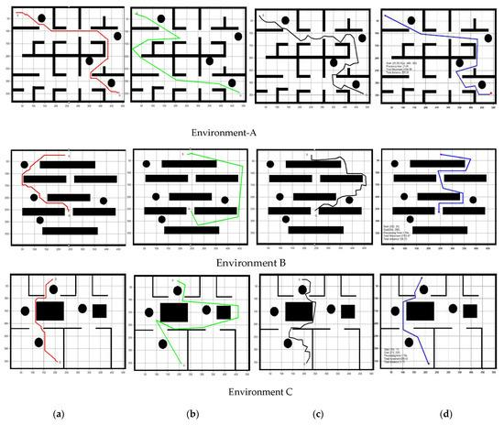
Summary
Path → where
Trajectory → how fast
Combined for real robot motion

Slide 45
Further Reading
Siciliano Robotics
LaValle Planning Algorithms
OMPL, MoveIt, PyBullet
Understanding planning is mastering robotics motion

Slide 46
Reflection questions
1. Conceptual Understanding & Distinction
How would you clearly distinguish between path planning and trajectory generation in a real robotic system? Can a robot operate effectively using only one of them? Why or why not?
Why is it insufficient to treat a planned path as directly executable by a robot without trajectory considerations?
In what situations might a “shortest path” be a poor choice for robot navigation?
2. Representation of the Environment
What are the trade-offs between grid-based, graph-based, and continuous representations in path planning?
How does the choice of environment representation affect computational efficiency and optimality of the solution?
In dynamic environments, what limitations arise from static map-based planning methods?
3. Algorithmic Reasoning
Dijkstra’s algorithm guarantees optimality—why is it still not always preferred in real-time robotic applications?
How does A* improve upon Dijkstra’s algorithm, and under what conditions does it degrade to Dijkstra’s behavior?
What are the advantages and weaknesses of sampling-based methods like RRT and PRM in high-dimensional spaces?
4. Constraints and Real-World Feasibility
Why must trajectory planning consider velocity, acceleration, and jerk constraints even if the path is collision-free?
What could go wrong if a robot follows a path that violates its dynamic constraints?
How do physical constraints of different robots (e.g., drones vs wheeled robots) influence trajectory design?

Slide 47
Reflection questions
5. Optimization and Trade-offs
Is the “shortest path” always the “best path”? What other cost functions might be more realistic?
How do we balance computational efficiency vs optimality in real-time path planning systems?
When would you prefer a suboptimal but fast solution over an optimal but slow solution?
6. Uncertainty and Robustness
How should path planning algorithms account for uncertainty in sensor data and environmental perception?
What are the risks of assuming perfect map knowledge in real-world navigation?
How can probabilistic approaches improve robustness in uncertain environments?
7. Dynamic and Real-Time Planning
Why is re-planning necessary in dynamic environments, and what are the computational challenges involved?
How do local planners complement global planners in autonomous navigation systems?
Can a purely global planner work effectively in real-time obstacle-rich environments? Defend your answer.

Slide 48
Reflection questions
8. Trajectory Smoothness and Control
Why is jerk minimization important in trajectory generation for precision robotics?
How does trajectory smoothness affect mechanical wear and energy efficiency?
What are the consequences of abrupt changes in velocity or acceleration in robotic motion?
9. Comparative Thinking
Compare grid-based planning vs sampling-based planning in terms of scalability and accuracy.
Compare deterministic vs probabilistic path planning approaches. Which is more suitable for unknown environments and why?
How do classical planning methods compare with learning-based approaches in modern robotics?
10. Design and Synthesis Questions
Design a path planning system for a warehouse robot that must avoid humans, optimize delivery time, and minimize energy use. What components would you include?
If you were to design a planner for a self-driving car in Kampala traffic conditions, what key challenges would you prioritize?
Propose an improvement to RRT that could make it more suitable for real-time autonomous drone navigation.

